Slide 1

Project Name: Employee Retention
Domain : HR Analytics
By Soumyaranjan Nayak

Slide 2
AGENDA
KPI’S REQUIREMENTS
DATA VISUALIZATION
KEY INSIGHTS
RECOMMENDATIONS

Slide 3

Key Performance Indicators (KPIs)
KPI:1-Attrition rate Vs Monthly income stats
KPI:2- Average Attrition rate for all Departments
KPI:3 – Average working years for each Department
KPI:4 – Average Hourly rate of Male Research Scientist
KPI:5 – Job Role Vs Work life balance
KPI:6 –Attrition rate Vs Year since last promotion relation

Slide 4
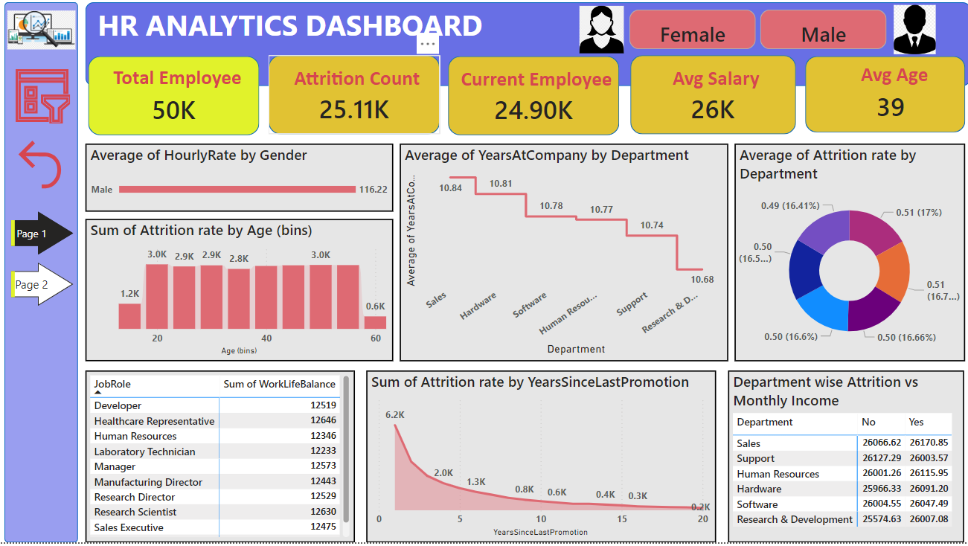
Dashboard: Page1

Slide 5
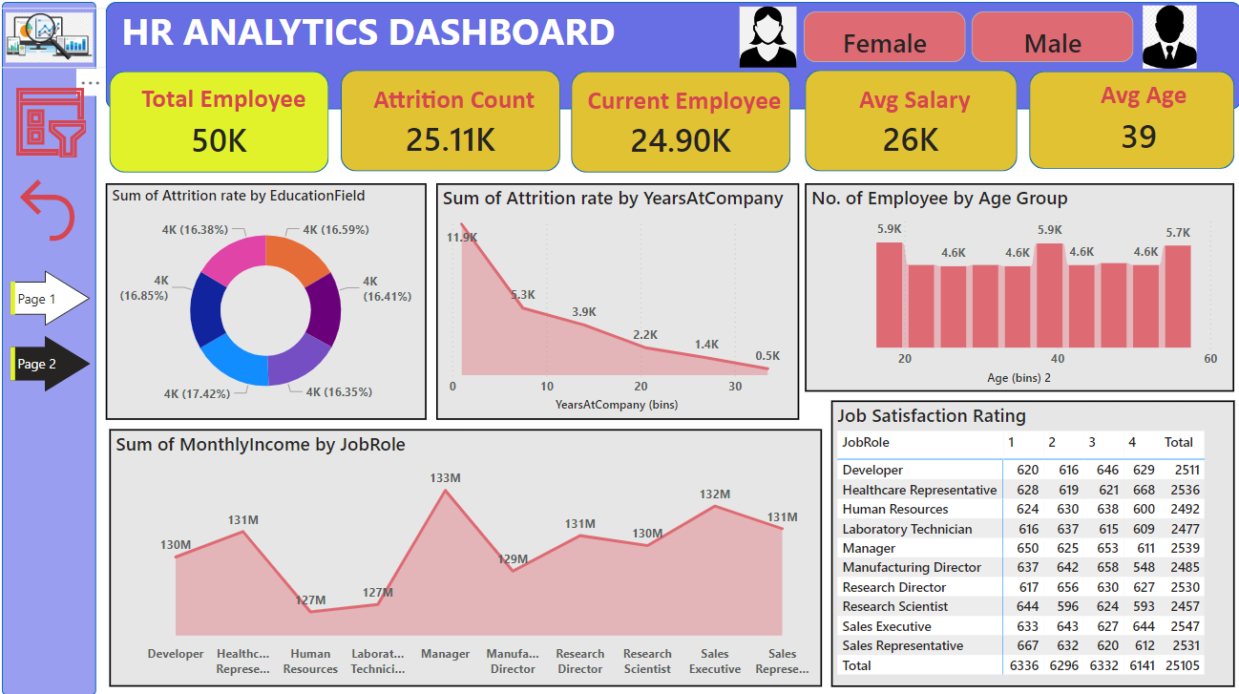
Dashboard : Page 2

Slide 6
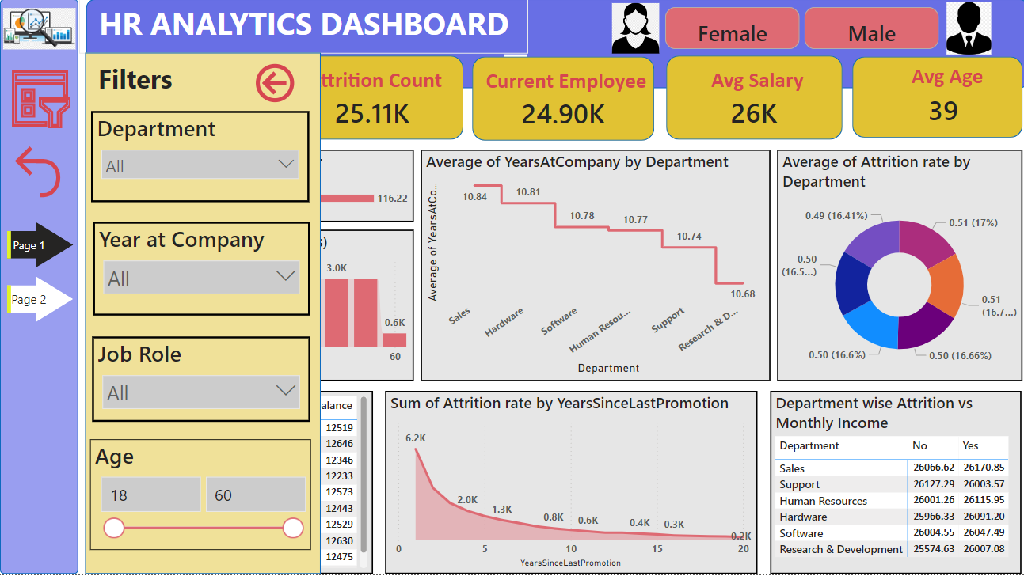

Slide 7
Key Insights
High Attrition Rate: With an attrition count of 25.11K out of 50K employees, nearly half of the workforce has left. Attrition is highest among employees with fewer years at the company, especially within the first 10 years.
Departmental Trends: Sales and Support show higher attrition rates (around 17%), indicating possible challenges specific to these departments.
Younger Employees: Attrition is higher in younger age groups (20–30), suggesting retention issues among newer or early-career employees.

Slide 8
Key Insights
Income and Roles: Managers and Research Directors have higher income, while roles like Sales Executives, with lower average income.
Job Satisfaction: Satisfaction is moderate across roles, but high-turnover roles may need improvement in job experience and engagement.
Promotion Frequency: Attrition decreases significantly with recent promotions, suggesting career progression is key for retention.

Slide 9
Recommendations
Focus on Early-Career Retention: Implement mentorship, career development, and engagement programs for new hires to improve early retention.
Support High-Attrition Departments: Address issues in Sales and Support with better career development, recognition, and stress management initiatives.
Review Compensation: Consider improving salaries or offering incentives in roles with high turnover but lower income, like Sales.

Slide 10
Recommendations
Enhance Engagement: Increase job satisfaction by offering more feedback, recognition, and growth opportunities, especially in high-turnover roles.
Increase Promotion Opportunities: More frequent promotions could help retain employees, especially those with long tenure.
Improve Work-Life Balance: Focus on flexible schedules and stress-relief options for demanding roles to reduce burnout.

Slide 11


